Slide 1
Economic Determinants
of Healthcare Decisions
2019 CDC Vaccination Data
2019 Census Income Data
Brandy Larramore - DA 10

Slide 2


Process of Project Analysis
Downloaded CDC Vaccine Data
Downloaded Census Income Data 2019
Explored the data in Excel using pivot tables, find and replace to replace unconverted symbols, and sorting.
Created python notebooks to analyze income and vaccination parameters, outliers, and trends.
Created FIPS column in income from geography column
Joined income and vaccination data on FIPS column
Added location to analysis and analyzed further
For this presentation visuals for income are blue
Visualizations for vaccinations are purple

Slide 3
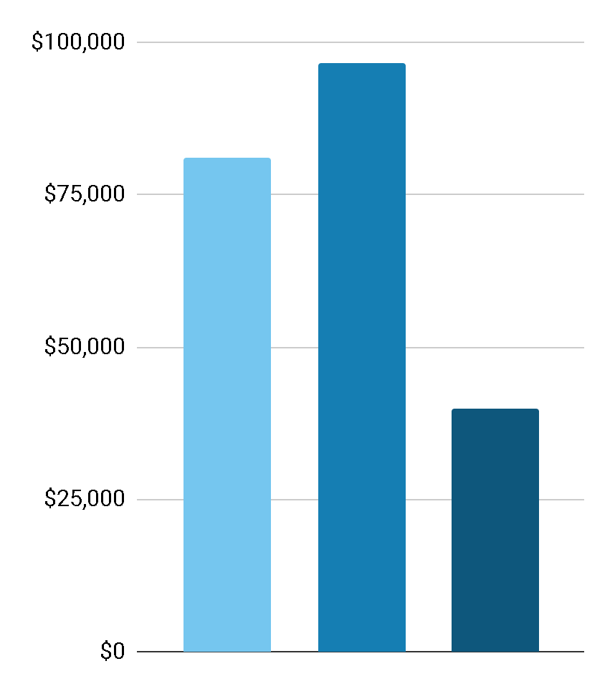

Median Income by Household Type
Household Types
The Census divides households into three categories:
Families
Married Couple Families
Non-Families
$96,571
$80,944
Family
$39,871
Married Couples
Non Family
Households
Families
Married
CoupleFamilies
Non-familes

Slide 4
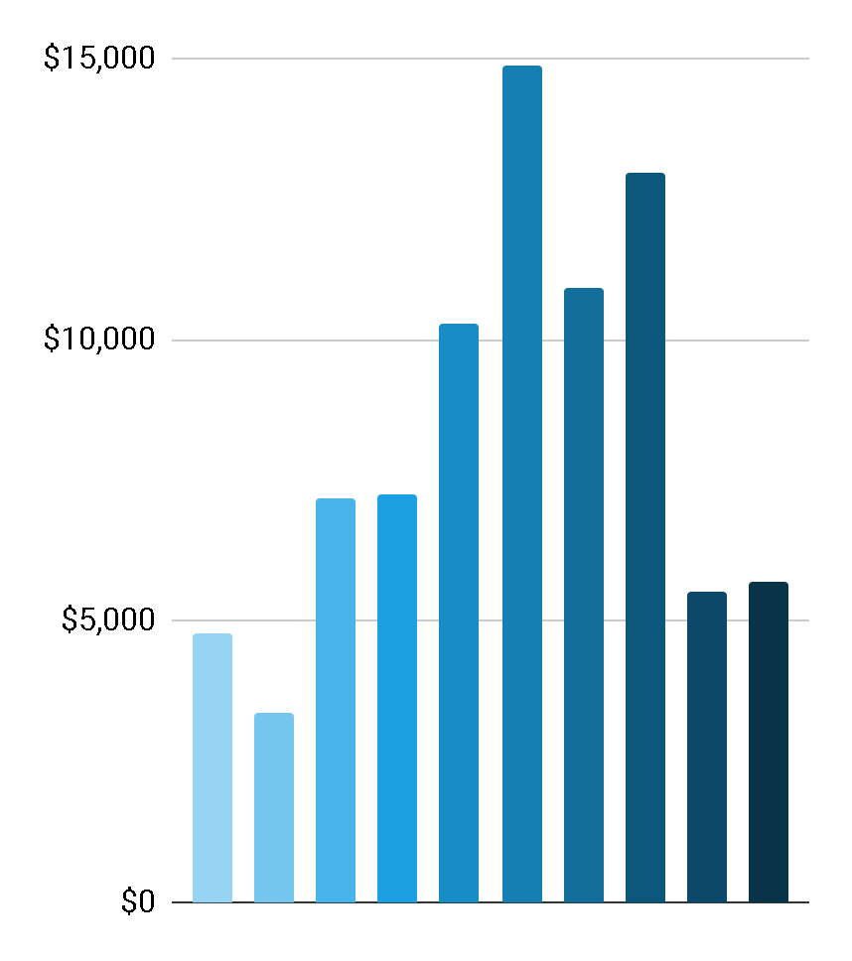
Household Incomes by Amount
<10k
> 200k
35k-49.9k
75k-99.9k
15k-24.9k
50k-74.9k
10k-14.9k
25k – 34.9k
100k-149.9k
150k-199.9k

Slide 5
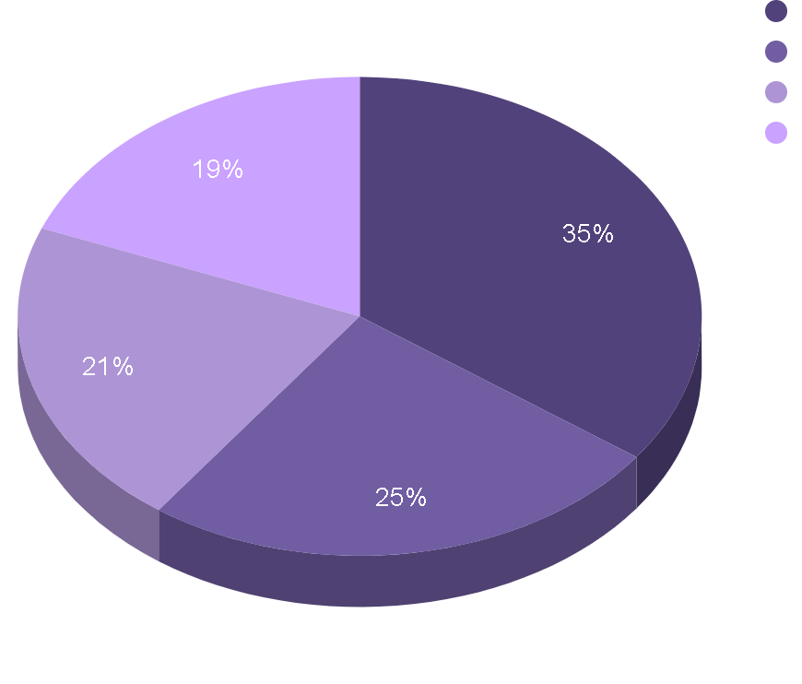
Distribution of Vaccine by Type
Td
Pneumococcal
Tdap
Zoster (Shingles)

Slide 6
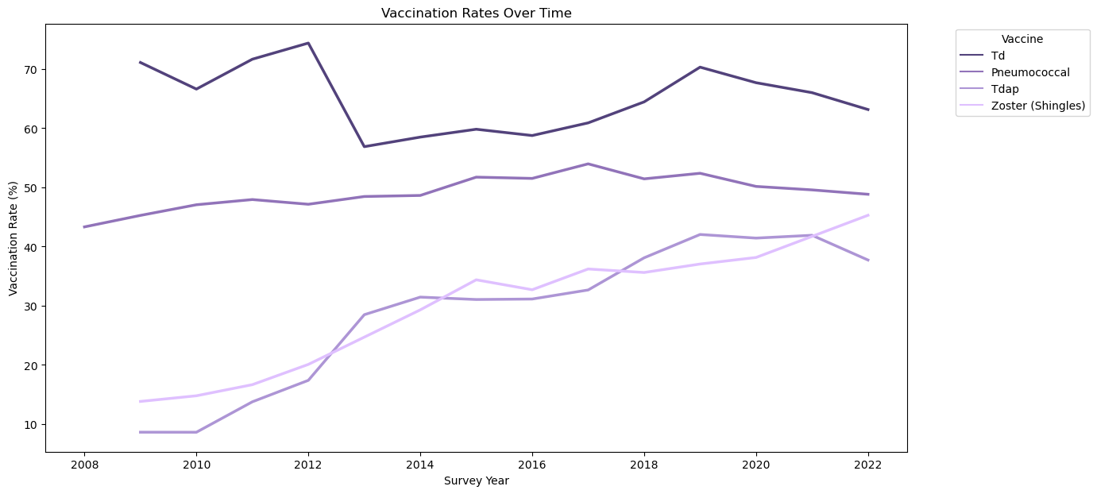

Slide 7
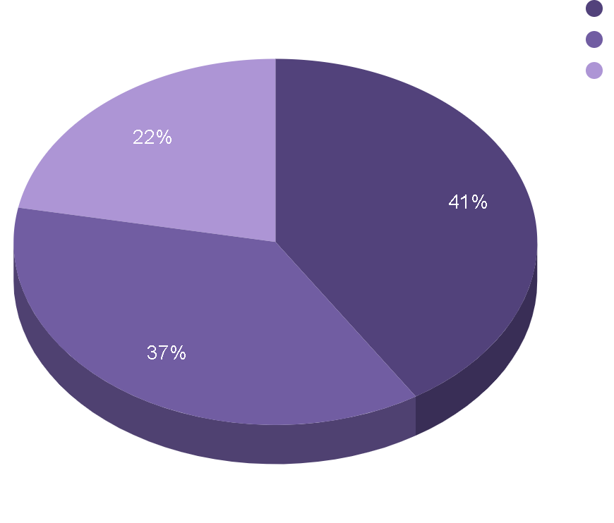
Vaccination Coverage by Race
65 or Older
18-64
18 or Older at Increased Risk

Slide 8
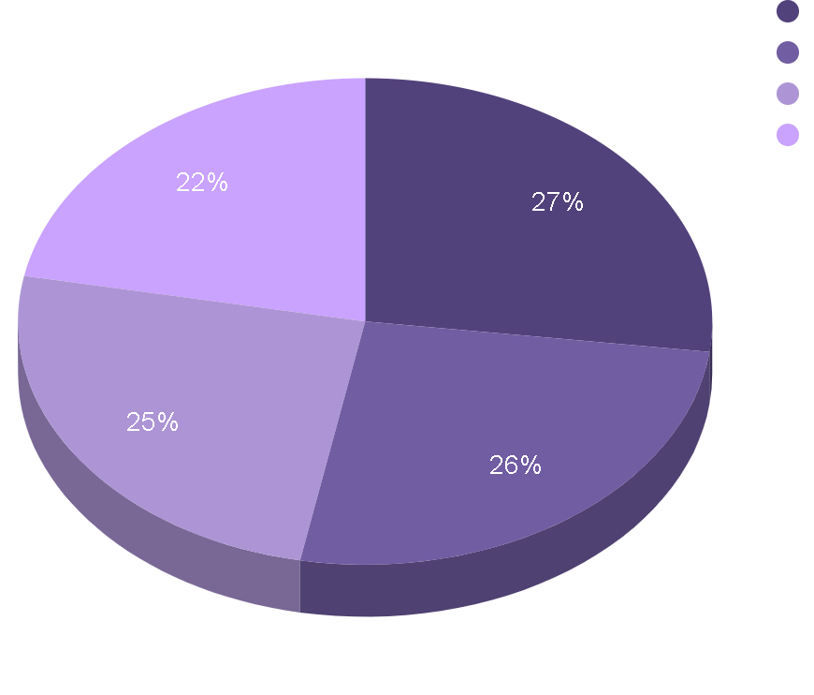
Vaccination Coverage by Race
White
Other or Multiple
Black
Hispanic

Slide 9
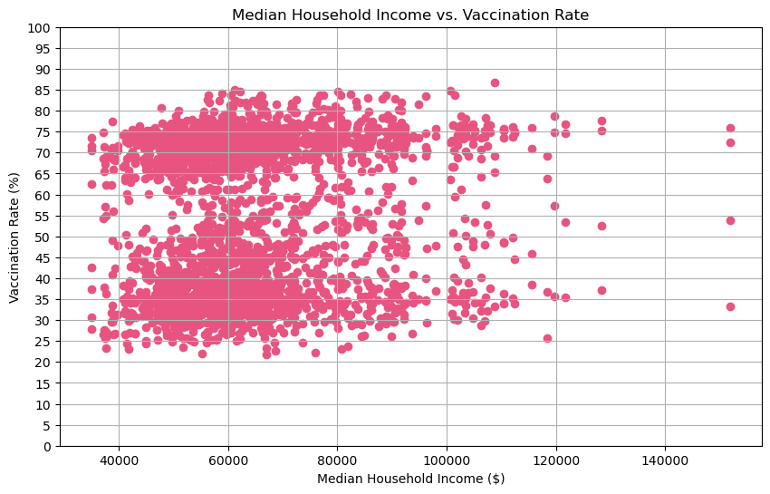

Slide 10
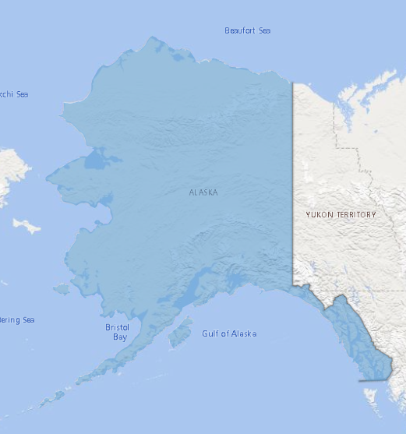
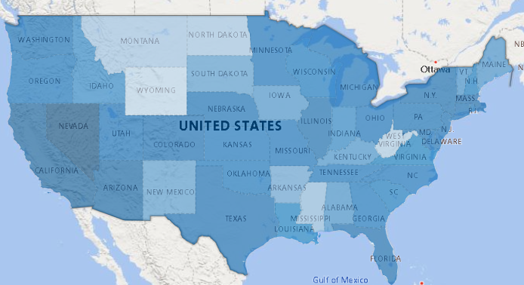
Income by State
Nevada only included
two data points,
one including Las Vagas,
heavily skewing it’s
state outcome
Lowest
Highest

Slide 11
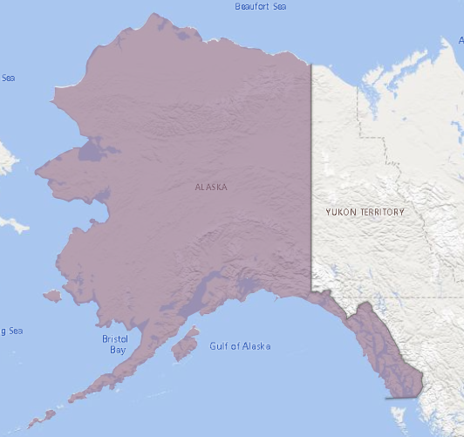
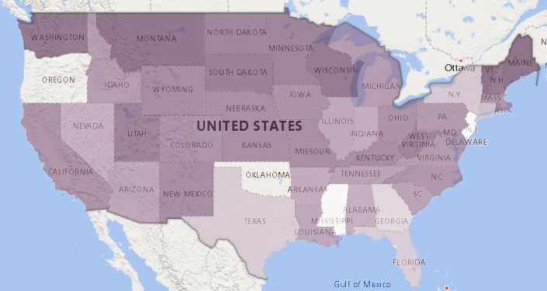
Vaccination Percent By State
No Data for 2019
Lowest
Highest

Slide 12
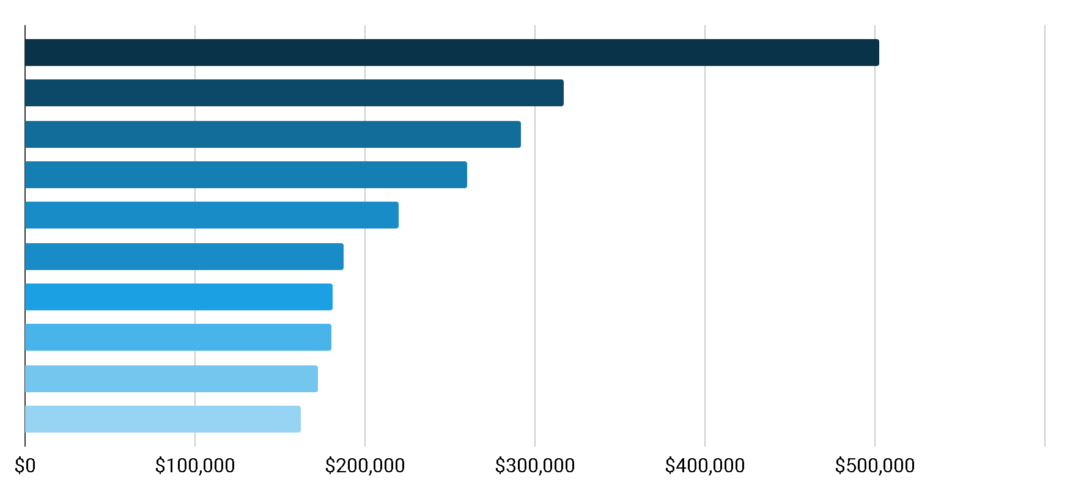
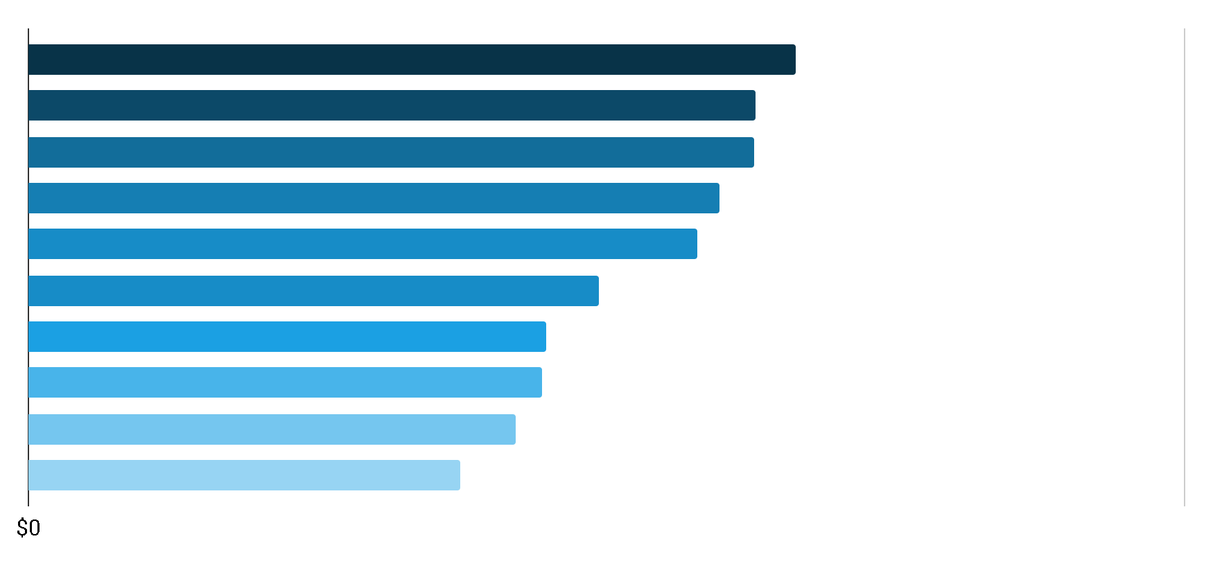
Nevada
California DC
Arizonia
Massachusetts
Florida
New York
Illinois
Connecticut
Texas
Top Ten Average Household Incomes by State
Average Household Income
Wyoming
West Virginia
North Dakota
Montana
Mississippi
Alaska
Arkansas
New Mexico
South Dakota
Iowa
Bottom Ten Average Household Incomes by State
Average Household Income

Slide 13
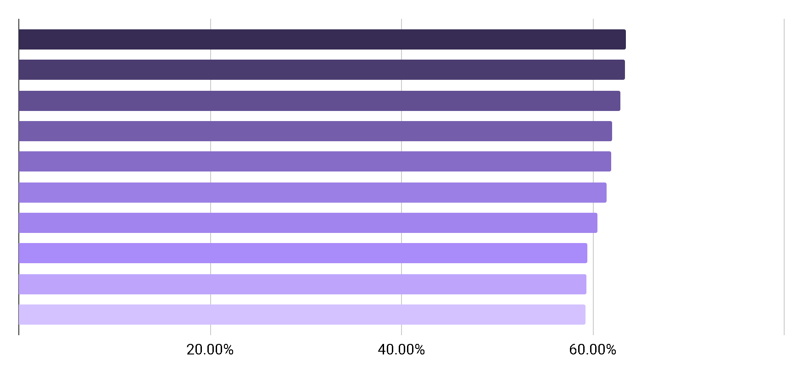
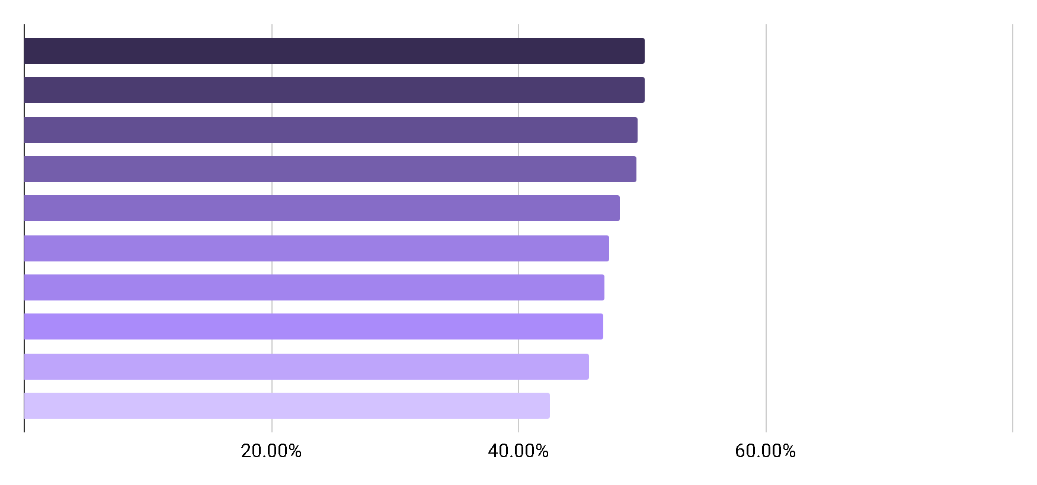
Vermont
Maine
Montana
Wisconsin
Washington
New Hampshire
South Dakota
Minnesota
West Virginia
Utah
Top Ten Total Vaccination
Percent by State
Average Vaccination Rate
Mississippi
Georgia
Florida
Texas
New York
Connecticut
Nevada
Alabama
Indiana
Arkansas
Bottom Ten Total Vaccination Percent by State
Average Vaccination Rate

Slide 14
Nevada
California DC
Arizonia
Massachusetts
Florida
New York
Illinois
Connecticut
Texas
Vermont
Maine
Montana
Wisconsin
Washington
New Hampshire
South Dakota
Minnesota
West Virginia
Utah
Wyoming
West Virginia
North Dakota
Montana
Mississippi
Alaska
Arkansas
New Mexico
South Dakota
Iowa
Mississippi
Georgia
Florida
Texas
New York
Connecticut
Nevada
Alabama
Indiana
Arkansas

Slide 15
Nevada
California DC
Arizonia
Massachusetts
Florida
New York
Illinois
Connecticut
Texas
Vermont
Maine
Montana
Wisconsin
Washington
New Hampshire
South Dakota
Minnesota
West Virginia
Utah
Wyoming
West Virginia
North Dakota
Montana
Mississippi
Alaska
Arkansas
New Mexico
South Dakota
Iowa
Mississippi
Georgia
Florida
Texas
New York
Connecticut
Nevada
Alabama
Indiana
Arkansas

Slide 16
Nevada
California DC
Arizonia
Massachusetts
Florida
New York
Illinois
Connecticut
Texas
Vermont
Maine
Montana
Wisconsin
Washington
New Hampshire
South Dakota
Minnesota
West Virginia
Utah
Wyoming
West Virginia
North Dakota
Montana
Mississippi
Alaska
Arkansas
New Mexico
South Dakota
Iowa
Mississippi
Georgia
Florida
Texas
New York
Connecticut
Nevada
Alabama
Indiana
Arkansas

Slide 17
Nevada
California DC
Arizonia
Massachusetts
Florida
New York
Illinois
Connecticut
Texas
Vermont
Maine
Montana
Wisconsin
Washington
New Hampshire
South Dakota
Minnesota
West Virginia
Utah
Wyoming
West Virginia
North Dakota
Montana
Mississippi
Alaska
Arkansas
New Mexico
South Dakota
Iowa
Mississippi
Georgia
Florida
Texas
New York
Connecticut
Nevada
Alabama
Indiana
Arkansas

Slide 18







Income Findings:
01
Married Couple Families have the highest reported income
Nevada has the highest average income as an outlier,
with California second.
Iowa has the lowest.
02
03
The most frequently earned income is between $50,000 to $75,000
Census Income Data

Slide 19






Vaccine Findings:
01
TD vaccine is the most administered vaccine in this dataset
Vermont is the state with the highest vaccination rate reported
Arkansas in the state with the lowest vaccination rate
02
03
The age group with the highest vaccination rate are 65 and older
CDC Vaccination Data

Slide 20
Correlations:
There does not seem to be a correlation between income and vaccination status only
01
There seems to be an inverse correlation between income and vaccination rate per state
02
States with higher incomes tend to have lower vaccination rates
&
States with lower income tend to have higher vaccination rates
03

